Slide 1
yeast knockout analyses

Slide 2
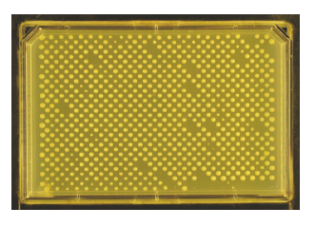
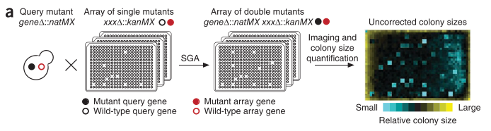
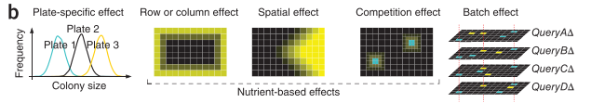
kuzmin et al experimental setup
focused on deleterious negative trigenic interactions
more accurately scored than positive interactions?
“generally more functionally informative than positive digenic interactions”? so more mechanistic insight into function/wiring
Collins … Weissman 2006, Genome Biology
﻿Baryshnikova et al 2010, Nature Methods

Slide 3

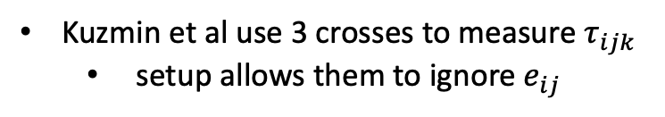








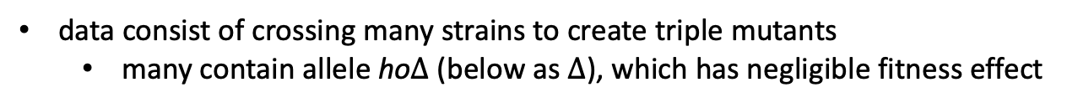

kuzmin et al experimental setup
$$τ_{ijk}$$
$$e_{ij}$$
data consist of crossing many strains to create triple mutants
many contain allele ho$∆$ (below as $∆$), which has negligible fitness effect
$$f_{i}$$
$$f_{j}$$
$$f_{k}$$
$$e_{jk}$$
$$e_{ik}$$
Kuzmin et al use 3 crosses to measure $τ_{ijk}$
setup allows them to ignore $e_{ij}$
Crosses
$f_{i∆}$ X${ f}_{k}$
$f_{j∆}$ X${ f}_{k}$
$f_{ij}$ X${ f}_{k}$
measure ${f_{i},f_{j}, e}_{ik}$, $e_{jk}$
measure $τ_{ijk}$
“query”
strain
“array”
strain

Slide 4









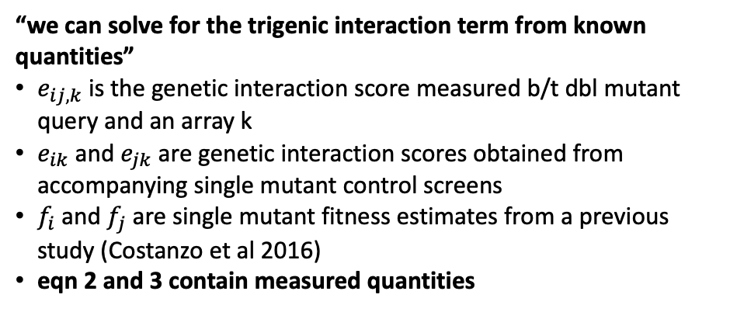

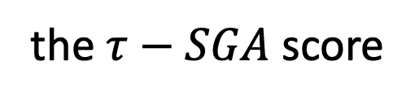




the $τ−SGA$ score
$$τ_{ijk}$$
$$e_{ij}$$
$$f_{i}$$
$$f_{j}$$
$$f_{k}$$
(1)
$τ_{ijk}=f_{ijk}−f_{i}f_{j}f_{k} − e_{jk}f_{i}− e_{ik}f_{j}$ $− e_{ij}f_{k}$
$$e_{jk}$$
$$e_{ik}$$
$f_{ijk}=f_{i}f_{j}f_{k}+{e_{ij}f_{k}+e}_{jk}f_{i}+ e_{ik}f_{j}$ $+ τ_{ijk}$
$$τ_{ijk}$$
*all interactions (in blue) from crossing dbl mutant ij with single mutant k
(2)
$$e_{ij,k}=f_{ijk}−f_{ij}f_{k}$$
$$e_{ij}$$
$$f_{i}$$
$$f_{j}$$
$$f_{k}$$
$$e_{ij,k}=f_{ijk}−{(f}_{i}f_{j}+e_{ij})f_{k}$$
$$e_{jk}$$
$$e_{ik}$$
$$e_{ij,k}=f_{ijk}−f_{i}f_{j}f_{k}−e_{ij}f_{k}$$
$$f_{ijk}=f_{i}f_{j}f_{k}+e_{ij}f_{k}+e_{ij,k}$$
“we can solve for the trigenic interaction term from known quantities”
$e_{ij,k}$ is the genetic interaction score measured b/t dbl mutant query and an array k
$e_{ik}$ and $e_{jk}$ are genetic interaction scores obtained from accompanying single mutant control screens
$f_{i}$ and $f_{j}$ are single mutant fitness estimates from a previous study (Costanzo et al 2016)
eqn 2 and 3 contain measured quantities
$$∴e_{ij,k} =e_{jk}f_{i}+e_{ik}f_{j}+τ_{ijk}$$
(3)
$$τ_{ijk} ={e_{ij,k} − e}_{jk}f_{i}−e_{ik}f_{j}$$

Slide 5
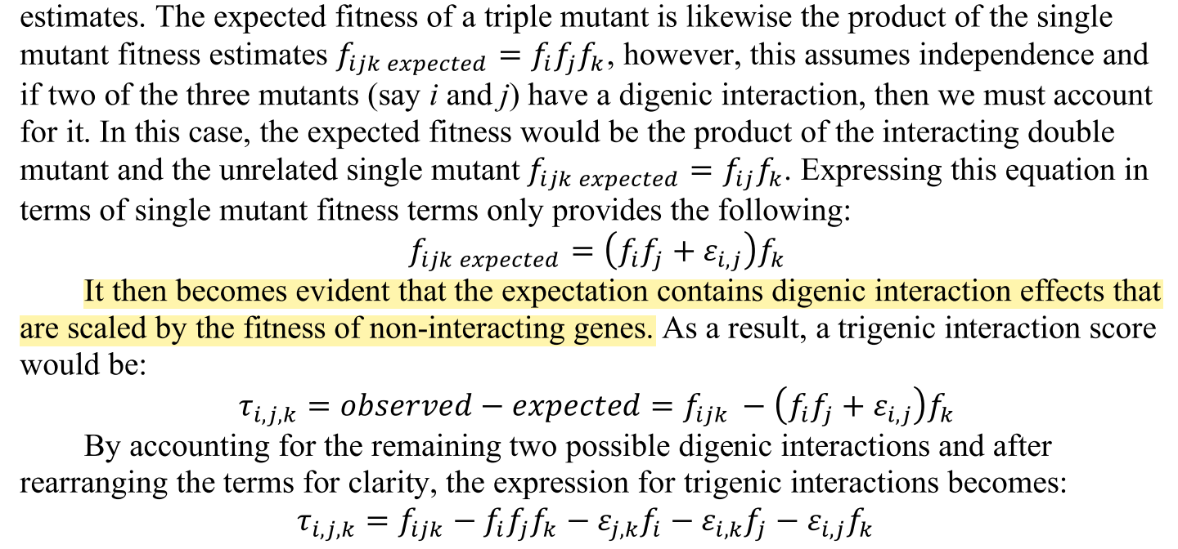
pairwise epistatic coefficients scaled by fitness of noninteracting gene?
their verbal derivation of their formula
conclusion: combining multiplicative and additive scales at the pairwise interaction level creates strange scalings for higher-order dependencies?

Slide 6


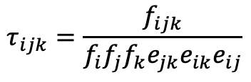


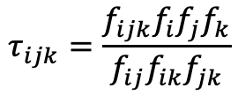
multiplicative version, from scratch
$$τ_{ijk}$$
$$e_{ij}$$
$$f_{i}$$
$$f_{j}$$
$$f_{k}$$
$$f_{ijk}=f_{i}f_{j}f_{k}e_{jk}e_{ik}e_{ij}τ_{ijk}$$
$$e_{jk}$$
$$e_{ik}$$
solve for tau
$$τ_{ijk}$$
$$τ_{ijk}=\frac{f_{ijk}}{f_{i}f_{j}f_{k}e_{jk}e_{ik}e_{ij}}$$
$$e_{ij}$$
$$f_{i}$$
$$f_{j}$$
$$f_{k}$$
$$e_{jk}$$
$$e_{ik}$$
$$e_{ij} =\frac{f_{ij}}{f_{i}f_{j}}$$
$$e_{ik} =\frac{f_{ik}}{f_{i}f_{k}}$$
$$e_{jk} =\frac{f_{jk}}{f_{j}f_{k}}$$
plug in multiplicative epistasis
$$τ_{ijk}=\frac{f_{ijk}f_{i}f_{j}f_{k}}{f_{ij}f_{ik}f_{jk}}$$

Slide 7
part 1
replicate their results to prove we understand their data

Slide 8
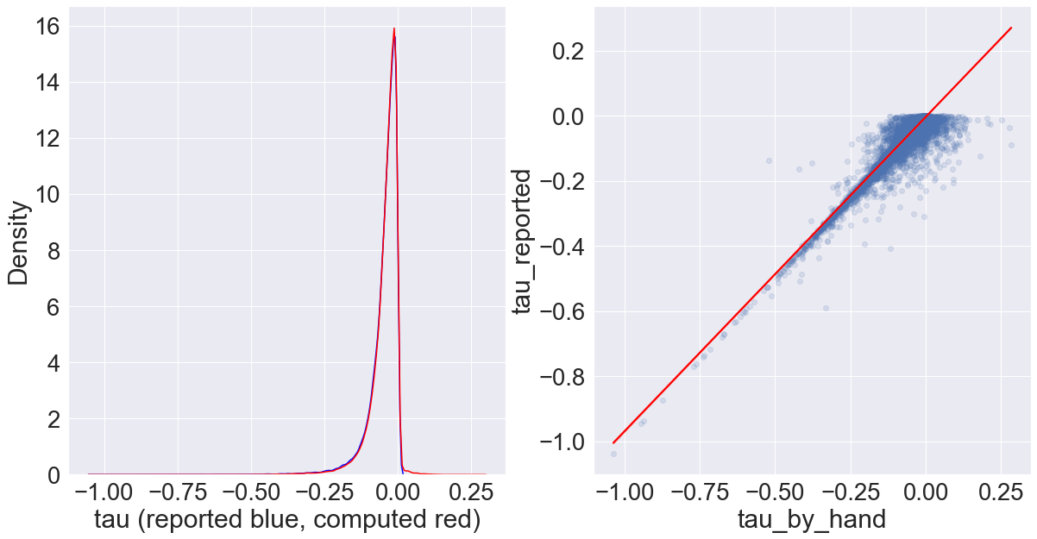
I can’t replicate their results, but I get close?
statistic | tau_reported | tau_by_hand
mean | -0.046795 | -0.043689
median | -0.032901 | -0.031430
std | 0.0521378 | 0.0485061
tau_reported: a column in their data table S1
tau_by_hand: me calculating tau according to description in supplement, grabbing some quantities from Costanzo et al2016
note: blue (reported results) and red (my recalculation) curves overlap too much to be useful here
Pearson correlation b/t reported results and my re-calculations: 0.962393
*all measurements have variability, I might be pulling values from diff table

Slide 9
part 3
comparing results using their formula and standard multiplicative/additive formula

Slide 10
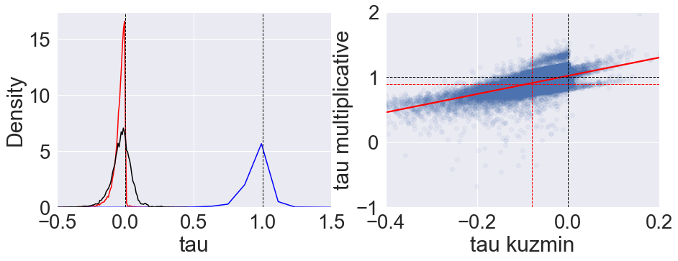
Kuzmin formula vs multiplicative and additive models
Pearson correlation: 0.58574
kuzmin formula (red) , additive model (black), multiplicative model (blue)
calculated significance threshold for multiplicative model using a quantile that corresponded to their cutoff value of -0.08 on their scale
red dashed lines: significance thresholds
black dashed lines: value where epistasis switches signs from negative to positive

Slide 11
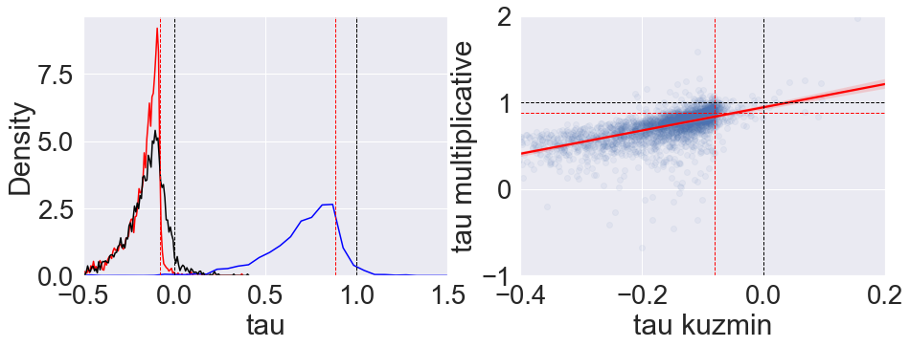
same as previous slide, but only for their ~3k interactions they report as “significant”
Pearson correlation: 0.5235
kuzmin formula (red) , additive model (black), multiplicative model (blue)
calculated significance threshold for multiplicative model using a quantile that corresponded to their cutoff value of -0.08 on their scale
red dashed lines: significance thresholds
black dashed lines: value where epistasis switches signs from negative to positive

Slide 12
epistasis sign switches
 |  | multiplicative model
 |  | “positive” (> 1) | “negative” (< 1) | Total
kuzmin model | positive (> 0) | 1199 | 711 | 1910
 | negative (< 0) | 23988 | 60213 | 84201
 | Total | 25187 | 60924 | 86111
86111, less than 91111 total because 5k nan’s
Notes:
multiplicative model has many more “positive” trigenic interactions (~1/3 of total) compared to mixed model (~2%)
like any two methods to quantify interactions, they won’t give exactly the same results but correlated results. Thus, if you were to select only negative results on one scale, some of these are going to be positive on another scale.

Slide 13
statistical significance
False positives?
They use a threshold of -0.08, such that trigenic interaction scores below this are significant
This corresponds to the ~16% quantile of their distribution
The value on the multiplicative scale that corresponds to this quantile is ~0.88 (< 1 is negative interaction)
~14% of their significantly negative results (using their formula) are above the 0.88 significance threshold on the multiplicative scale
their reported false positive rate is 20%
TO DO: False negatives?
a little more tricky, not sure how they got their significant list b/c there are 13k trigenic interactions below their threshold of -0.08 but they only report ~3k
but I can still look at interactions that fall above -0.08 on their scale (not significantly negative) but are significantly negative on multiplicative scale
TO DO: what about interactions that we detect as significantly positive

Slide 14
to definitely do
make v. brief review (~3-5 sentences) of readings on additive vs multiplicative scales, put in overleaf
full additive, full multiplicative, multiplicative with additive interaction
redo a couple of Kuzmin et al’s analyses (simple correlations mentioned in results)
new trigenic interactions?
can we redo their validation and get better false positive/negative rates
look at Beerenwinkel et al 2007, explanation for “lines”, from mixing of scales?
to maybe do
See what studies have cited Kuzmin et al and used their data and/or formulae
google trigenic interactions, 3-way interactions
collect the diversity of ways people quantify epistasis (experimental studies, mutation correlation studies)
minDC score from another yeast trigenic study in Cell Reports (Haber et al 2013)
mutual information
was miscalculating higher order interactions a one-off mistake, or is it more systemic in literature?
could we advocate for a standard way to calculate epistasis for everyone to adopt?

Slide 15
lingering notes
easy to go between additive and multiplicative models, but a model that includes both scales can introduce novel scaling factors that don’t make sense (this could be phrased more elegantly)
Summary of ongoing epistasis efforts:
unifying epistasis
multivariate bernoulli
reanalysis of data
trigenic Kuzmin et al data, correcting results
reanalysis of beerenwinkel/lenski data
other large datasets generated more recently?

Slide 16
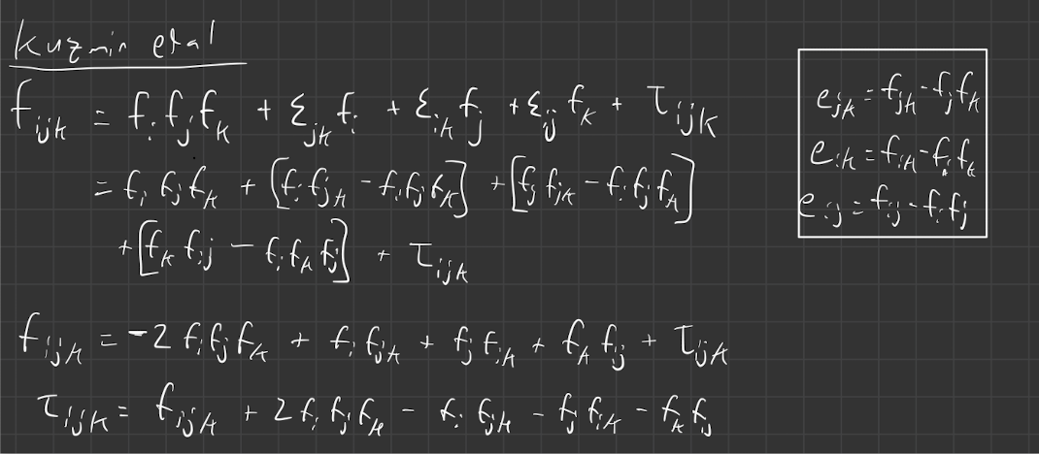
works that cited Kuzmin et al 2018
Tendler et al 2019
The Kuzmin et al 2018 equation is derived from an Isserlis Null model

Slide 17
Kuzmin 2020 paper

Slide 18
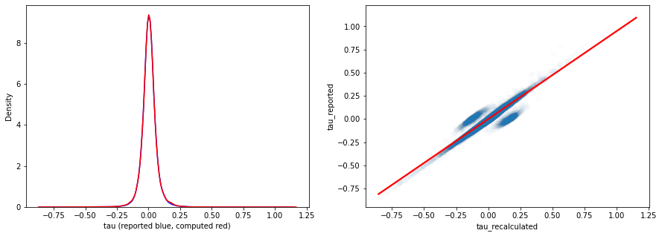
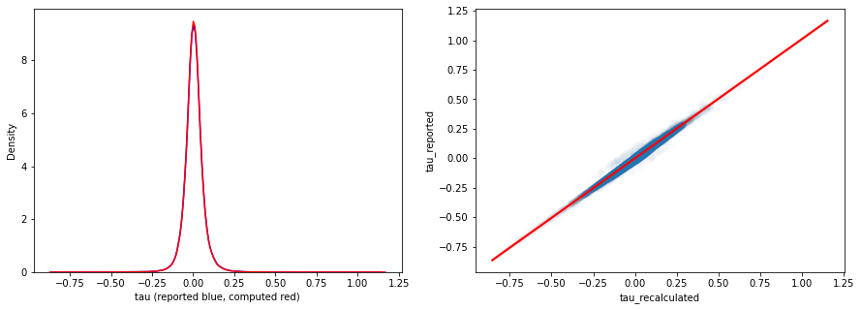



Kuzmin 2020 paper
$$τ_{ijk} ={e_{ij,k} − e}_{jk}f_{i}−e_{ik}f_{j}$$
where $e_{ij,k}=f_{ijk}−f_{ij}f_{k}$
$$τ_{ijk} ={f_{ijk}−f_{ij}f_{k}− e}_{jk}f_{i}−e_{ik}f_{j}$$
removing abs(recalculated – reported) > 0.1
leaves 98.9% of data, ~187k interactions
pearson corr = 0.997
Notes:
expand, cofirm it equals isserlis

Slide 19
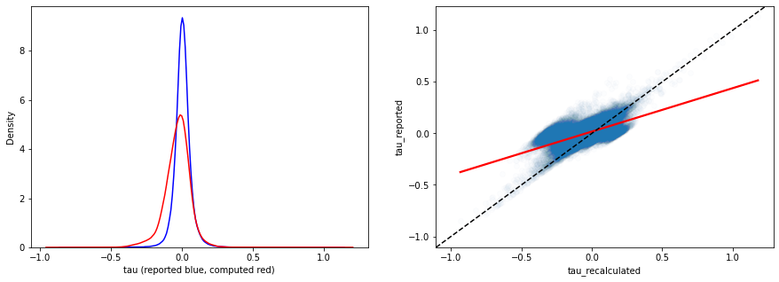
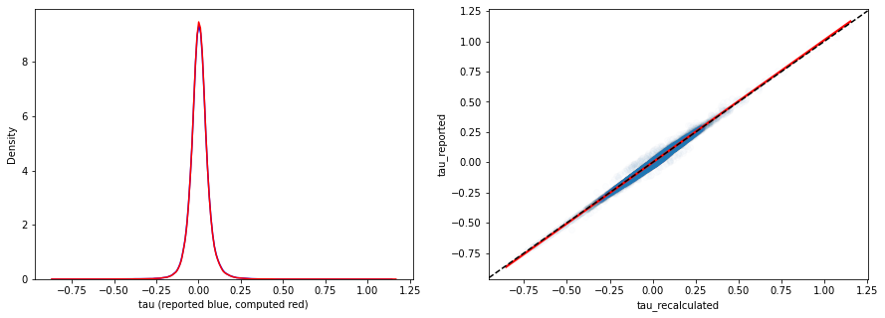

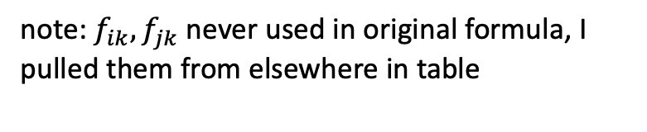


Kuzmin 2020 paper
using Isserlis formula instead
$$τ_{ijk} ={f_{ijk}+{2f_{i}f_{j}f_{k}− f}_{ij}f_{k}−f}_{ik}f_{j}−f_{jk}f_{i}$$
note: $f_{ik},f_{jk}$ never used in original formula, I pulled them from elsewhere in table
negative bias??
subtracting too much?
$$τ_{ijk} ={f_{ijk}−f_{ij}f_{k}− e}_{jk}f_{i}−e_{ik}f_{j}$$
$$τ_{ijk} ={f_{ijk}+{2f_{i}f_{j}f_{k}− f}_{ij}f_{k}−(f}_{i}{f_{k}+e_{ik})f}_{j}−{(f}_{j}f_{k}+ e_{jk})f_{i}$$
$f_{ik}≠{(f}_{i}f_{k}+ e_{ik})$ ??
$f_{jk}≠{(f}_{j}f_{k}+ e_{jk})$ ??
Notes:
this is strange and we should prolly understand it

Slide 20
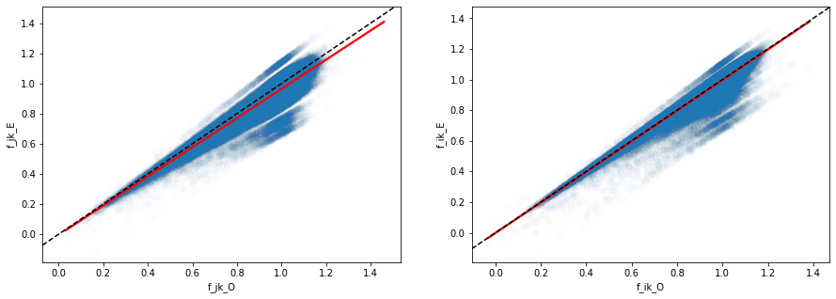




Kuzmin 2020 paper
$${f_{j}f_{k}− e}_{jk}$$
$${f_{i}f_{k}− e}_{ik}$$
$$f_{jk}$$
$$f_{ik}$$
measured value of double mutant systematically higher than expected based on how they calculate e,
substituting them in here leads to subtracting too much -> negative bias?
$$τ_{ijk} ={f_{ijk}+{2f_{i}f_{j}f_{k}− f}_{ij}f_{k}−f}_{ik}f_{j}−f_{jk}f_{i}$$

Slide 21
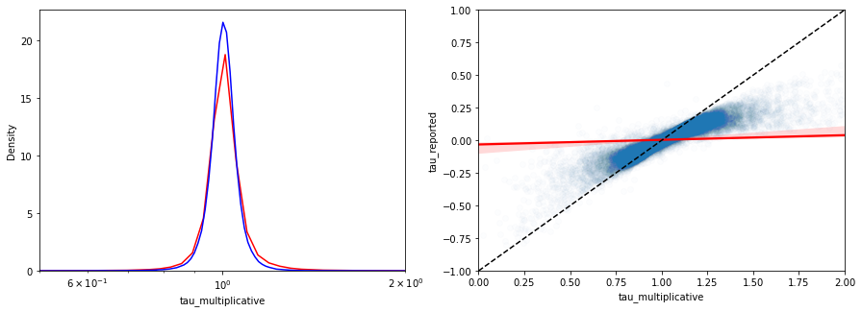
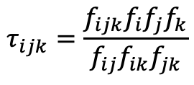
Kuzmin 2020 paper
solution
don’t use measured values of f_jk and f_ik
set e.g. f_jk = f_i*f_j + e_ij, where LHS is some imputed double mutant value
use to compute multiplicative tau_ijk
where
f_ij = f_i*f_j + e_ij
and e_ij_multiplicative = (f_i*f_j + e_ij)/ (f_i*f_j )
statistic | tau_reported | tau_multiplicative
mean | 0.0044771370 | 1.0127539478
median | 0.003783500000 | 1.0045042116
std | 0.05943114514 | 0.4070305624
$$τ_{ijk}=\frac{f_{ijk}f_{i}f_{j}f_{k}}{f_{ij}f_{ik}f_{jk}}$$
pearson corr = 0.24
note: log axis, reported shifted by +1
Notes:
spearman corr higher, how do ranks change?, list ranks in order, compare
just use the reported dbl mutant fitnesses, and compare their reported results with multiplicative formula
is there an additional measurement we aren’t using?
story: cumulant doesn’t measure multiplicative effects

Slide 22
7/6/2022 update

Slide 23

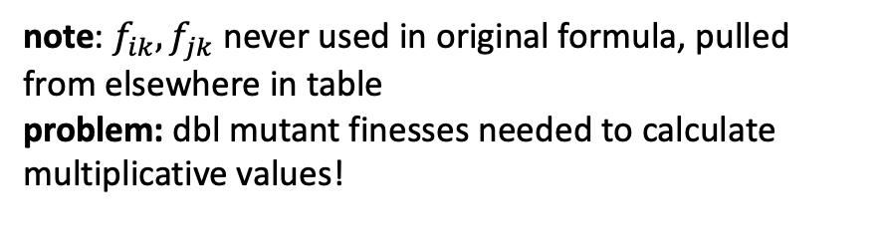
Kuzmin 2020 paper
original formula
$$τ_{ijk} ={f_{ijk}−f_{ij}f_{k}− e}_{jk}f_{i}−e_{ik}f_{j}$$
using cumulant formula instead
$$τ_{ijk} ={f_{ijk}+{2f_{i}f_{j}f_{k}− f}_{ij}f_{k}−f}_{ik}f_{j}−f_{jk}f_{i}$$
negative bias?
note: $f_{ik},f_{jk}$ never used in original formula, pulled from elsewhere in table
problem: dbl mutant finesses needed to calculate multiplicative values!
$$τ_{ijk} ={f_{ijk}+{2f_{i}f_{j}f_{k}− f}_{ij}f_{k}−(f}_{i}{f_{k}+e_{ik})f}_{j}−{(f}_{j}f_{k}+ e_{jk})f_{i}$$
$f_{ik}≠{(f}_{i}f_{k}+ e_{ik})$ ??
$f_{jk}≠{(f}_{j}f_{k}+ e_{jk})$ ??
Notes:
this is strange and we should prolly understand it

Slide 24
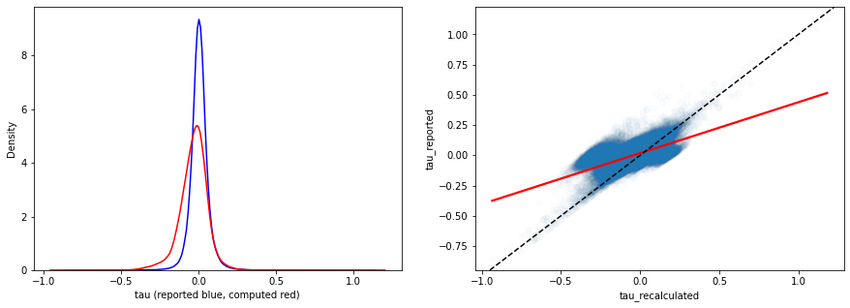
outlier analysis 1st pass: use “imputed” dbl mutant fitness
set
f_ik = f_i*f_k + e_ik
f_jk = f_j*f_k + e_jk
where LHS is imputed double mutant value
if I use reported values of f_ik and f_jk
then the multiplicative values are different from reported values b/c of different scales AND different input values
instead of comparing multiplicative values to reported values, could compare to recalculated cumulant values and use reported double mutant fitness in both calculations
but using reported f_ik and f_jk results in a negative bias w/ cumulant values, such that using their reported cutoff of +/- 0.08 results in many significantly negative interactions on cumulant scale (that weren’t originally reported) that aren’t significantly negative on the multiplicative scale, which we could report as false positive but…
using reported dbl mutant values

Slide 25
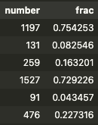
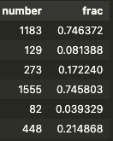
outlier analysis 1st pass: use “imputed” dbl mutant fitness
cmulant +/- 0.08
p < 0.05
mulitplicative 0.9,1.1
p < 0.05
both multiplicative and reported positive
both multiplicative and cumulant positive
only reported positive
only cumulant positive
only multiplicative positive
only multiplicative positive
both multiplicative and reported negative
both multiplicative and cumulant negative
only reported negative
only cumulant negative
only multiplicative negative
only multiplicative negative
Notes:
when multiplicative is significant but cumulant not, are these less likely to be in protein complexes (physical interactions)

Slide 26
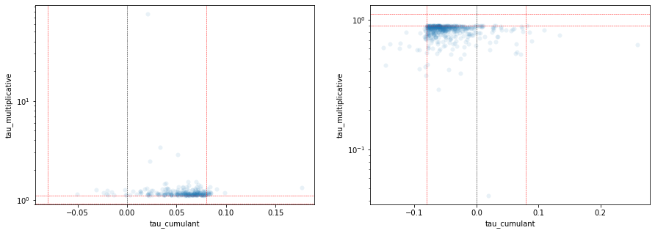
Kuzmin 2020 outlier analysis
multiplicative significantly positive
cumulant not
multiplicative significantly negative
cumulant not
cumulant negative!
cumulant positive!
some significantly so!

Slide 27
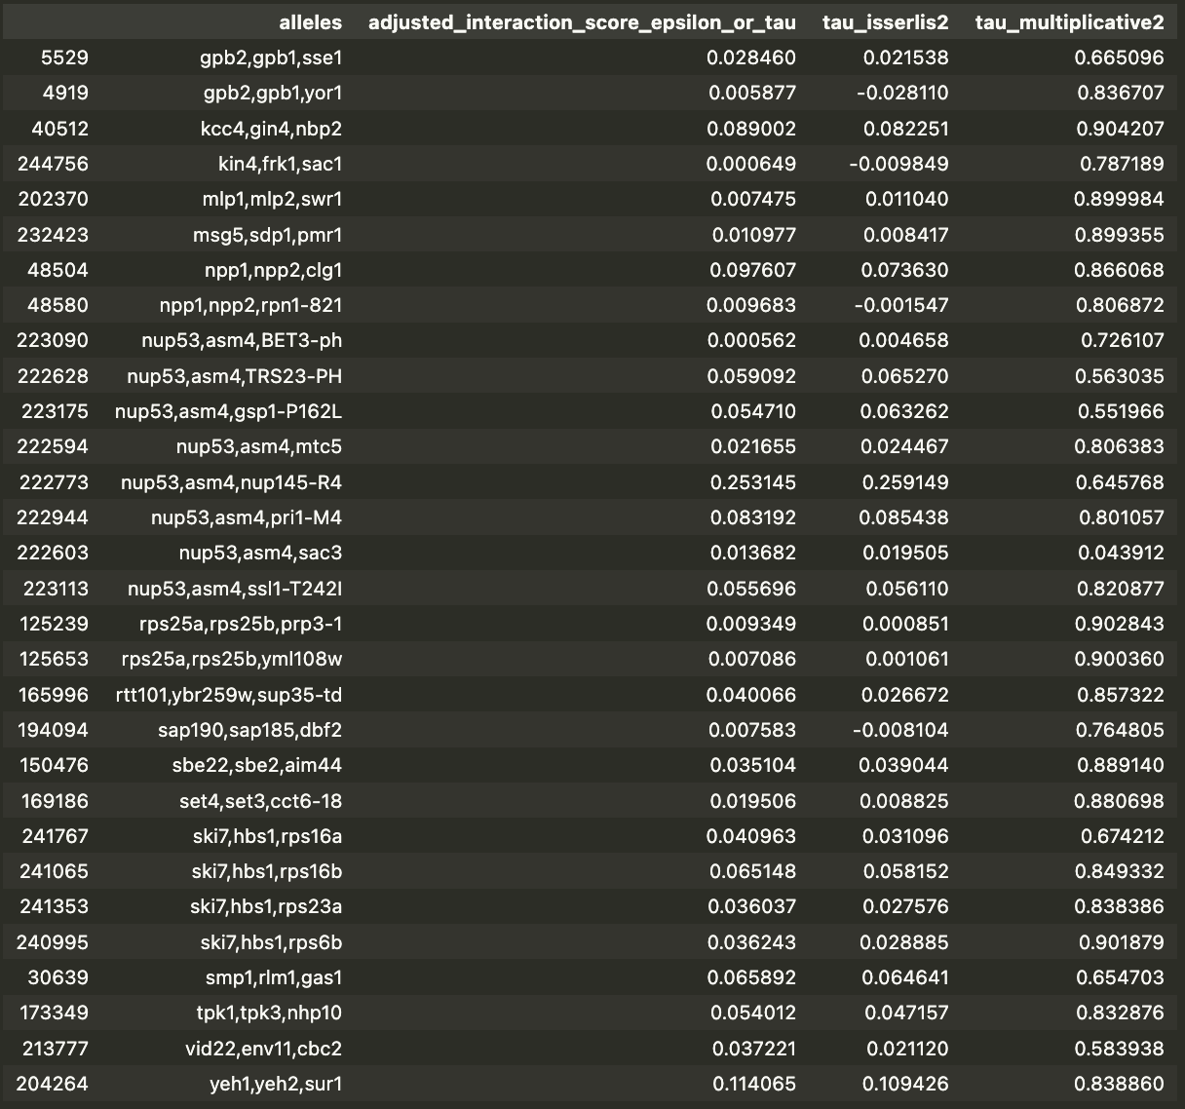
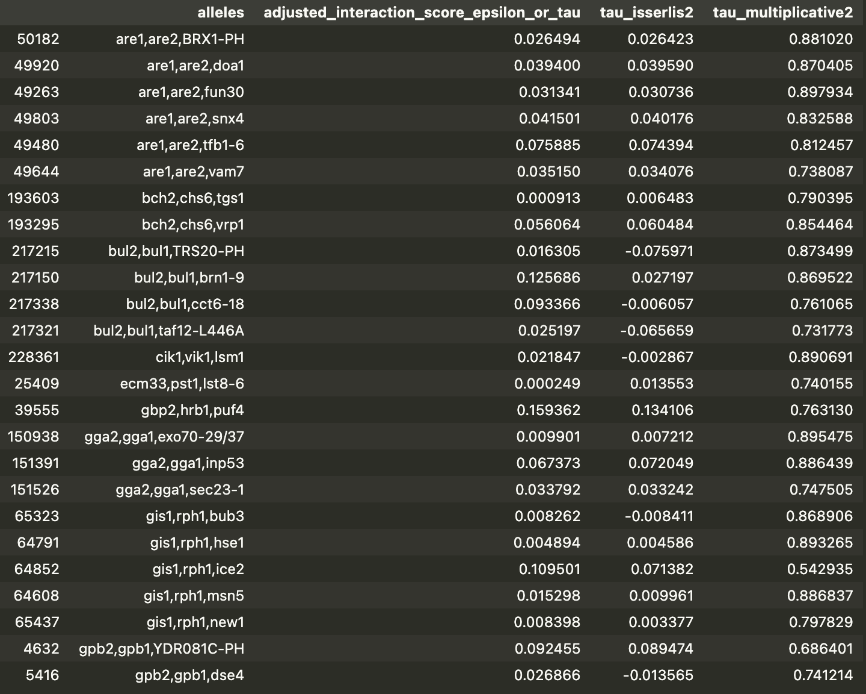
Kuzmin 2020 outlier analysis
multiplicative significantly negative
cumulant positive
Notes:
if pairwise signal is strong, then triple signal Iis strong, i.e. if there’s experimental noise, underestimate digenic score would overestimate trigenic score
do they have physical interctions, see database for physical interactions, look at correspondence b/t physical and genetic interactions
protein complexes
linear regression to see if not accurately estimating digenic score leads to over/under estiamtion of trigenic score. e.g. to explain many trigenic scores that all have same 2 genes, could correcting them by some constant make them all insignificant
our list is “better” than their list in terms of…. how do they claim that their list is reasonable, what analyses do they do? see 2018 and 2020 papers

Slide 28
7/20/22 update

Slide 29
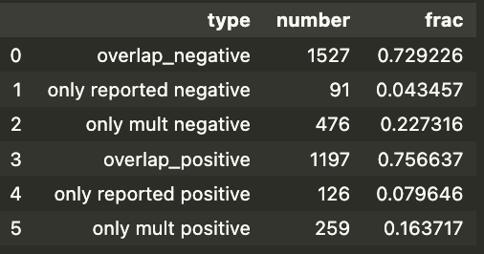
Kuzmin 2020 outlier analyses
FROM LAST TIME:
comparison of reported outliers with those found using multiplicative formula
for the fraction (“frac”) column, the number in “number” column was divided by all outliers (reported and multiplicative) of that type (positive or negative)
both multiplicative and reported negative
only reported negative
only multiplicative negative
both multiplicative and reported positive
only reported positive
only multiplicative positive
Notes:
contingency table
–positive, no effect, negative
dbl mutant to validate false negatives, redo it and get better estimates? lower false positive and lower false negative rates?

Slide 30
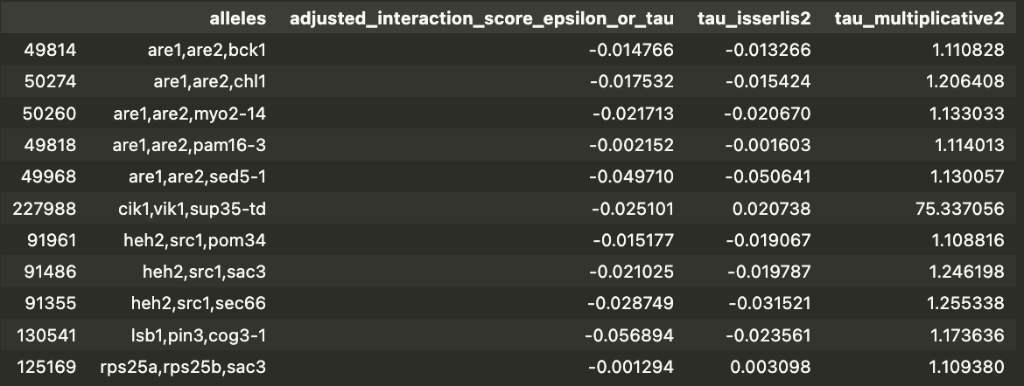
Kuzmin 2020 outlier analysis
multiplicative significantly positive
cumulant negative
Notes:
if you change pairwise genetic score does interaction go away
e_ij + delta makes many trigenic scores disappaear
robustness analysis, are tigenic scores stable under some small perturbation of pairwise scores

Slide 31
Kuzmin 2020 outlier analyses
downloaded physical interactions from BioGRID
assigned a gene triplet “1” if 2+ of 3 possible pairs were involved in physical interaction, “0” otherwise
downloaded GO categories from yeastgenome.org
assigned a gene triplet “1” if ALL 3 pairs were involved in same GO category at least once (sometimes all 3 gene pairs were in multiple GO categories), “0” otherwise
Kuzmin et al instead used some other custom “SAFE” analysis to classify functional categories
Used hypergeometric distribution to test for significant enrichment
Notes:
how exactly did they classify physical interactions

Slide 32
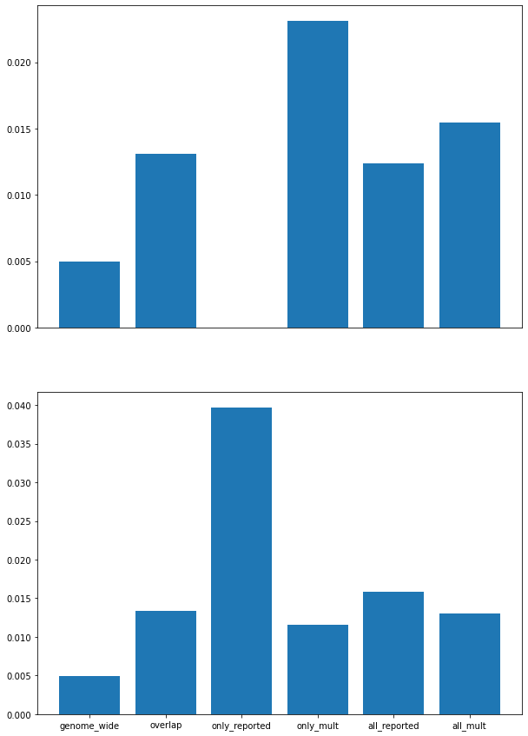
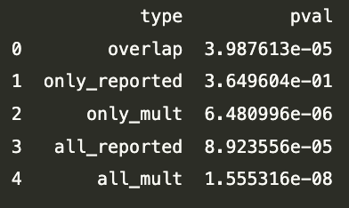
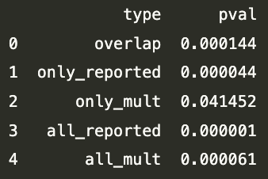
physical interactions
negative outliers
negative outliers
hypergeom test
conclusions:
multiplicative formula detects novel trigenic interactions (not detected as significant by cumulant formula) that are significantly enriched for physical interactions (compare “only_mult” category with “genome_wide”). Biologists may care about these!
OVERALL, multiplicative formula does better than the cumulant for negative outliers but NOT for positive outliers (compare “all_reported” category with “all_mult”)
pretty big diff
proportion
(triplets with 2+ pairs involved in physical interaction)
positive outliers
positive outliers
hypergeom test
diff, but somewhat similar
category
Notes:
report analysis with all 3 pairs
have a table with X out of Y so ppl know num and denom
do fold change instead proportion, having both fine

Slide 33
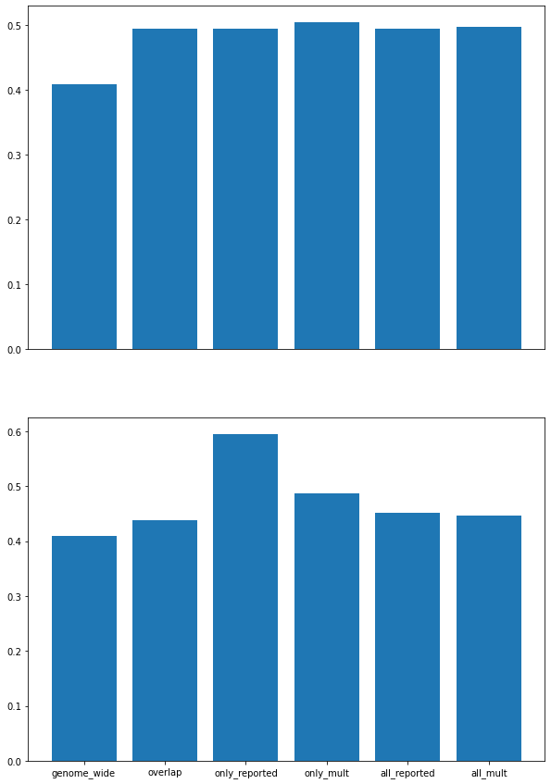
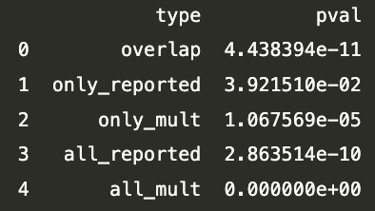
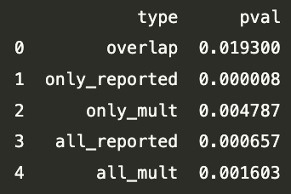
GO categories
negative outliers
negative outliers
hypergeom test
conclusions identical to those for physical interactions:
multiplicative formula detects novel trigenic interactions (not detected as significant by cumulant formula) that are significantly enriched for physical interactions (compare “only_mult” category with “genome_wide”). Biologists may care about these!
OVERALL, multiplicative formula does better than the cumulant for negative outliers but NOT for positive outliers (compare “all_reported” category with “all_mult”)
proportion
(triplets with ALL 3 pairs belonging to same GO category)
positive outliers
positive outliers
hypergeom test
category
Notes:
read and understand what negagive vs positive is supposed to mean biologically, are these the wrong tests for positive interactions?
what about paralogs: is this all data or subset?
draft some questions to chad about where to pull single mutant fitnesses and double mutant fitnesses
mrs3-mrs4 paralog pair, do those results change like ski7-hbs1

Slide 34
Kuzmin 2020 outlier analyses
TO DO:
revisit original data tables to investigate why measured values of f_jk != f_j*f_k + e_jk?
I was only to find fitness values to recalculate trigenic scores for ~70% of their data, I could go back and dig a little more to see why 30% is missing and where I might find it
this could also affect degree to which outliers enriched for physical interactions etc…
repeat some of their other analyses in 2020 paper
fraction of trigenic interactions story could change for an exemplary paralog pair they highlight throughout their paper

Slide 35
Kuzmin 2020 summary
Goal:
use genetic interaction analysis to study functional divergence of duplicated genes to understand duplicate gene retention
Background
budding yeast arose from WGD
following much gene loss, 551 duplicate gene pairs were retained
b/c of strong selection against functional redundancy, interesting to study functional divergence
previous approaches used evolutionary divergence, GO, co-expression, metabolic flux analysis etc.
here they use genetic interactions
Approach
240 double mutants deleted for pair of nonessential WGD paralog genes
240 of 551 total (above); others hard to work with
480 corresponding single mutants
colony size ~ fitness
240 dbl mutant queries crossed into “diagnostic array” ~1.2k genes (Kuzmin et al 2018)
examined > 530k double and > 250k tiple mutants

Slide 36
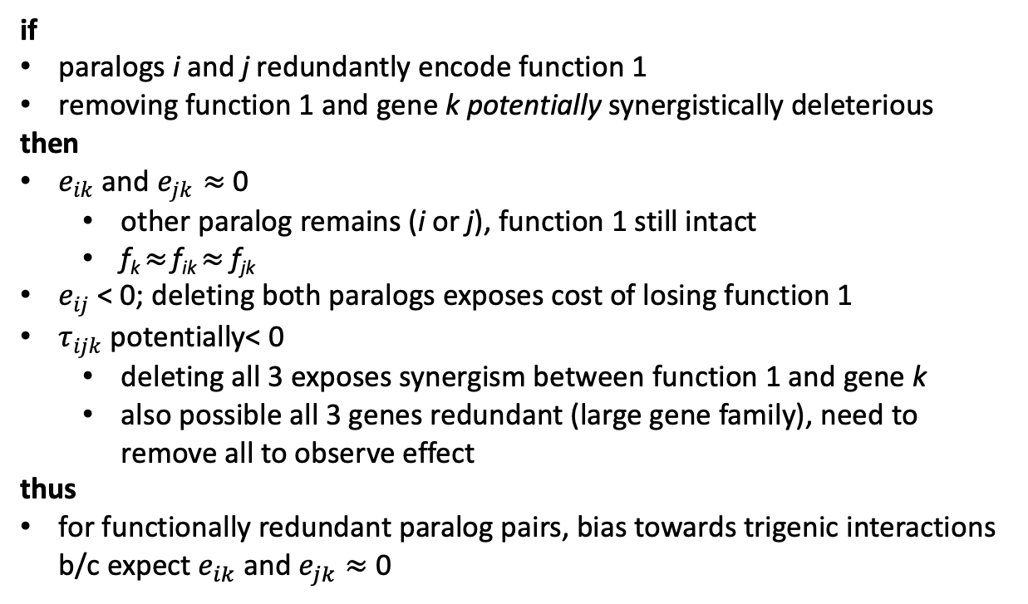


Kuzmin 2020 summary
Results
gave descriptive overview of pos.+neg. digenic+trigenic interactions, then focus on negative interactions for all downstream conclusions
if
paralogs i and j redundantly encode function 1
removing function 1 and gene k potentially synergistically deleterious
then
$e_{ik}$ and $e_{jk}≈$ 0
other paralog remains (i or j), function 1 still intact
f_{k} $≈$ f_{ik} $≈$ f_{jk}
$e_{ij}$ < 0; deleting both paralogs exposes cost of losing function 1
$τ_{ijk}$ potentially< 0
deleting all 3 exposes synergism between function 1 and gene k
also possible all 3 genes redundant (large gene family), need to remove all to observe effect
thus
for functionally redundant paralog pairs, bias towards trigenic interactions b/c expect $e_{ik}$ and $e_{jk}≈$ 0
function 1
$$τ_{ijk}$$
$$e_{ij}$$
$$i$$
j
$$k$$
$$e_{jk}$$
$$e_{ik}$$

Slide 37
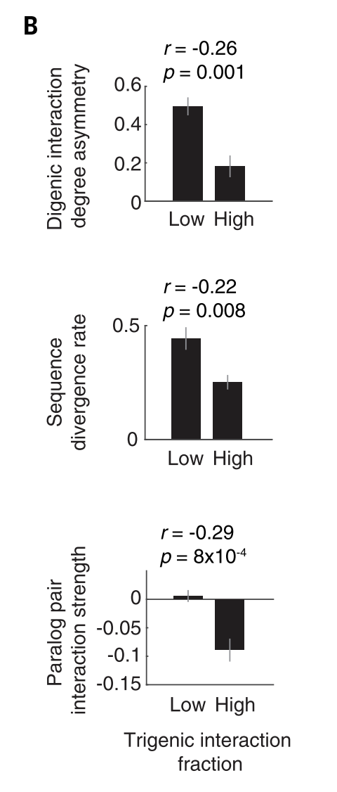
Kuzmin 2020 summary
Results
trigenic interaction fraction of paralog pairs associated with several fundamental physiological and evolutionary properties

Slide 38
Understand negative interactions biologically
From Hartman et al 2001:
Gene interactions underlie buffering
the buffering of variation in one gene is most often due to a small number of other genes that function in the same biochemical process
﻿The simplest, most obvious, and best appreciated mechanism for buffering genetic variation is redundancy
co-expression and functional annotation are signs functional redundancy… physical interactions might be?

Slide 39
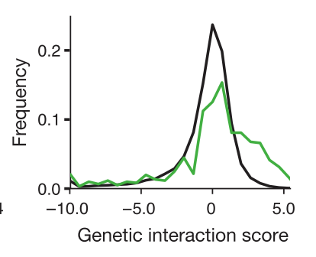
Understand positive interactions biologically
From Hartman et al 2001:
Gene interactions underlie buffering
the buffering of variation in one gene is most often due to a small number of other genes that function in the same biochemical process
Collins et al 2007
if 2 proteins carry out common function, expect positive interaction b/c in context of 1st deletion, 2nd deletion incurs no additional cost
for genes encoding physically interacting proteins, interaction effects bimodal
positive interactions for proteins that function coherently
no genetic interaction for proteins that carry out distinct/opposing functions
﻿many cases where proteins cooperate with each other even when they do not physically interact

